Slide 1
Software Engineering Image to Text
By
Under the guidance of
Dr. Sheikh Fahad Ahmad sir
Roll Number | Name
2110030359 | B Chihnita Reddy
2110030320 | SIRISILLA Nikhitha Reddy
2110030284 | Shivani Konduri
2110030283 | N Rajashri

Slide 2
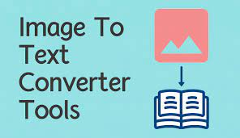
Image To Text
Our goal is to convert a given text image into a string of text.
Uploading a text image and saving it.
Submitting the given file and loading the text.
Show the given text with options for downloading and copying.
Converting to word document and pdf document.

Slide 3
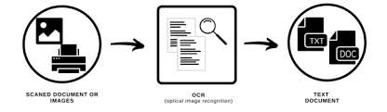
Existing solutions/ Naïve solutions
Create a web application to generate text from an image.
OCR (optical character recognition or optical character reader) is the electronic or mechanical conversation of images of typed, handwritten, or printed text into machine-encoded text, whether from a scanned document, a photo of a document, or a photo of a document.

Slide 4
Drawbacks
OCR text works efficiently with the printed text only and not with handwritten text. Handwriting must be learned by the pc.
OCR systems are expensive.
There is the need of a lot of space required by the image produced.
The quality of the image can be lost during this process.
Quality of the ultimate image depends on the quality of the first image.
All the documents got to be checked over carefully and then manually corrected. Not 100% accurate, there are likely to be some mistakes made during the method.
When users take a picture of their ID document with their smartphone or webcam, multiple steps are required to extract and structure the information.

Slide 5

Proposed Algorithm Design Technique
The technique is the development of web applications.
It is helpful for all the students, and employees for their work in all the ways.
Using the proposed design method is easily accessible without any flaws, advertisement, and premium nature.
You can use infinite times it gives the accurate content given in the image.

Slide 6
Data Structures needed
Often images are just represented as large bi-dimensional arrays; what you try to optimize are the algorithms you run on them.
Apart from that, graph structures and especially trees are quite useful. Spatial indexing can be achieved with quadtrees, and trees, in general, are a natural choice for image segmentation problems.
You also have fractal image compression, which is representing the whole image as a mathematical function. That's cool but that's not often used for real applications.

Slide 7
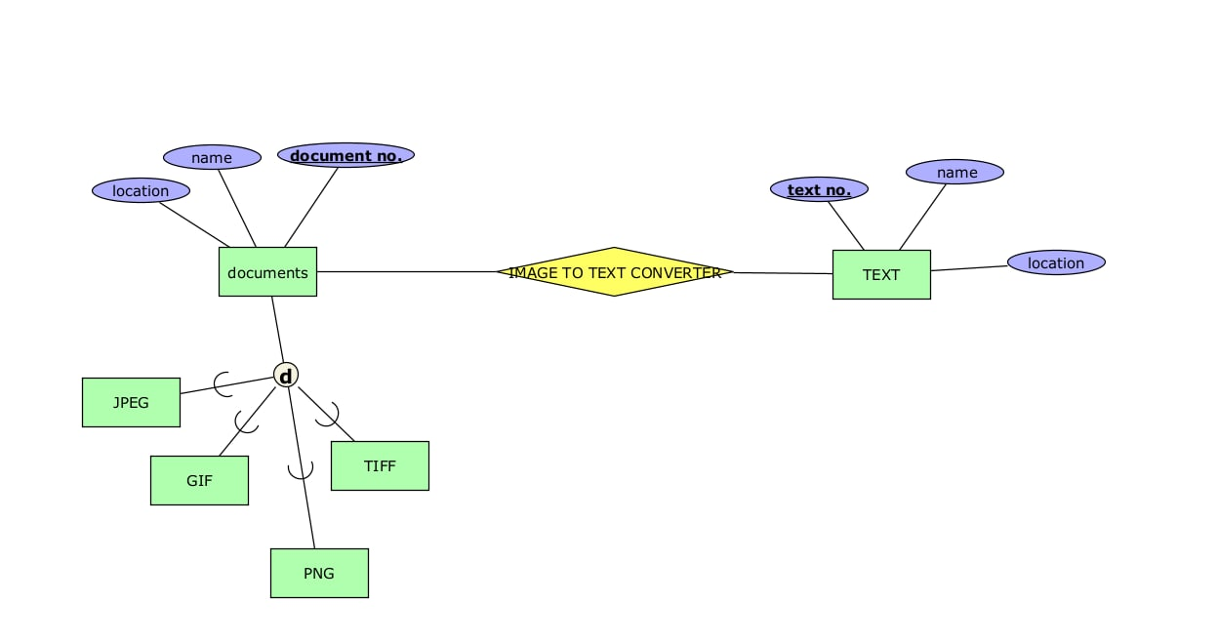
ER Diagram

Slide 8
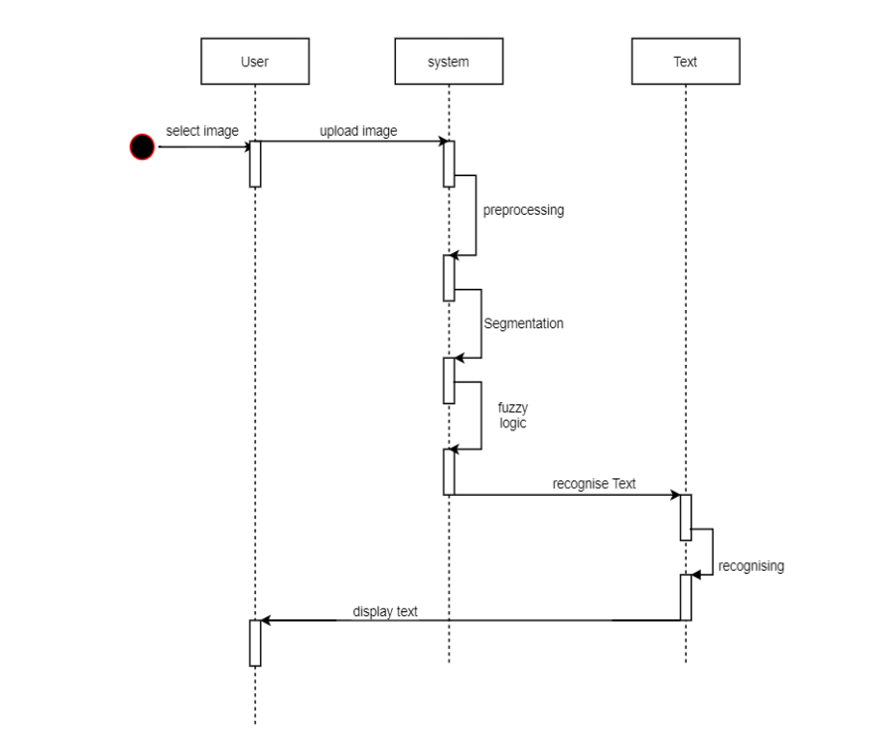
Sequence Diagram

Slide 9
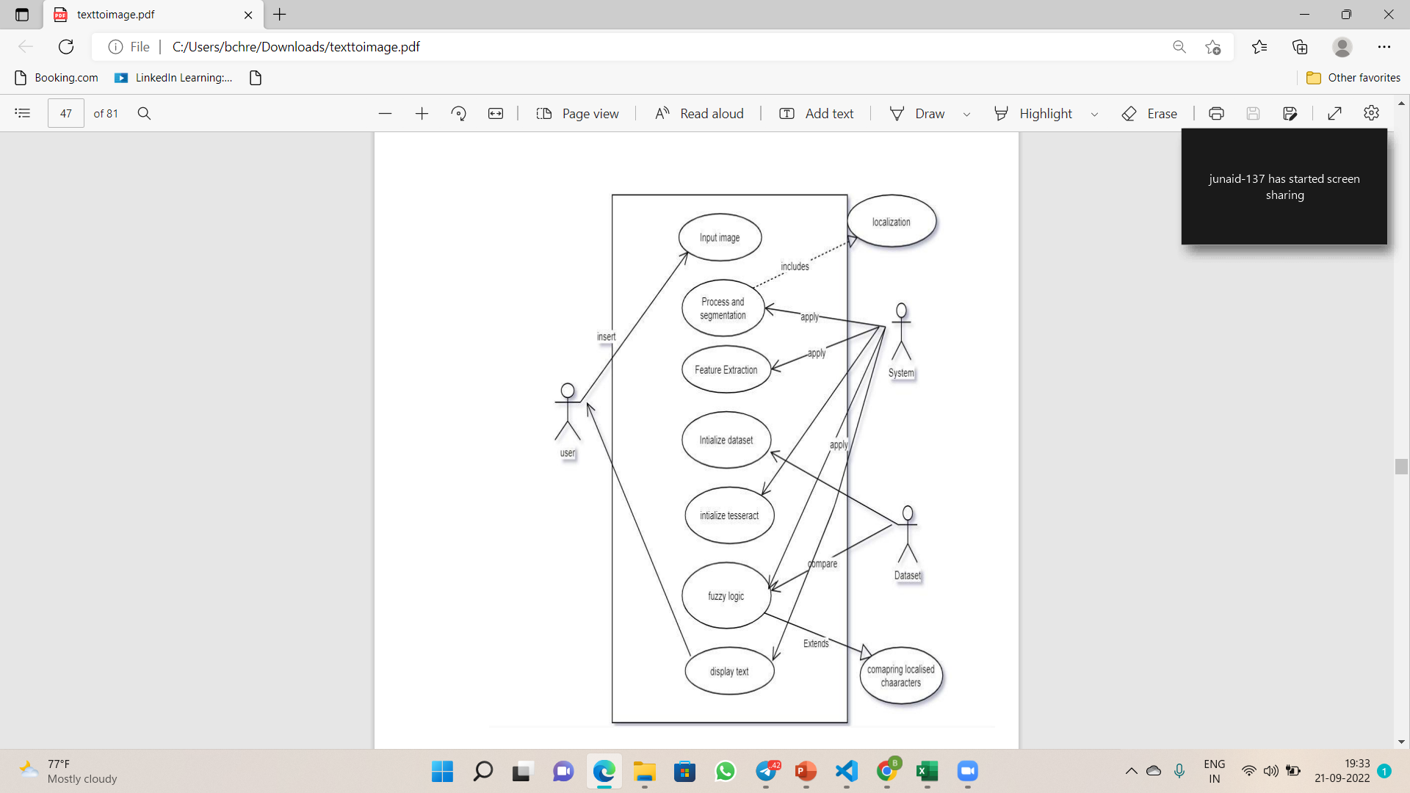
Use Case Diagram

Slide 10
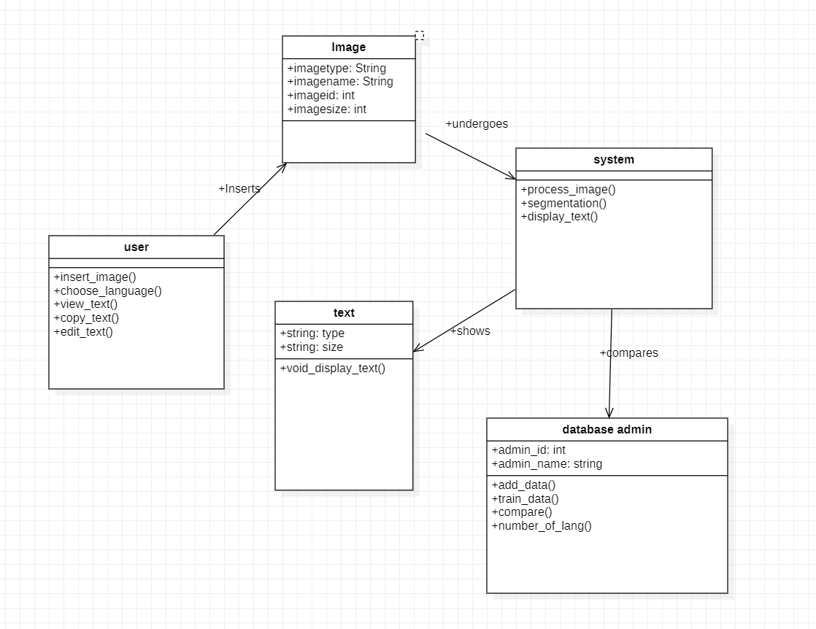
Class Diagram

Slide 11
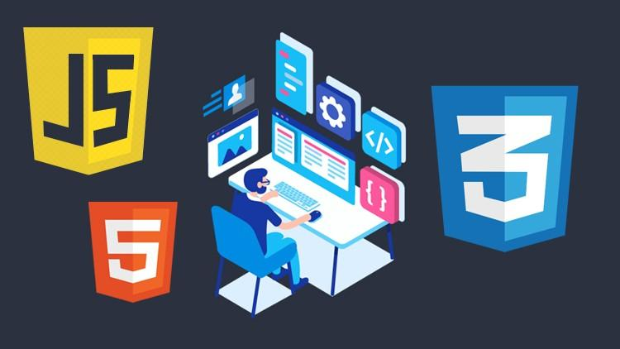
Project Requirements
Software Required
Front End: Html, CSS, JavaScript
Back End: Python, MySql
Control End: Software Engineering

Slide 12
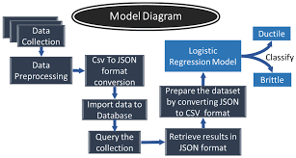
Tools
Pthon
Mysql
JavaScript
Html
Css
Terra
Star UML

Slide 13
Total Documentation
Purpose of the project:
Images and media are powerful communication devices.
They are useful for conveying concepts and information, and they can help improve
comprehension by reinforcing information provided in text.
One can use this program to extract the information from any image file.
Module:
Log into account.
Selecting the image.
Performing compression.
Uploading image.
Download in the form of jpg , pdf ,word.
Exit from the application.

Slide 14
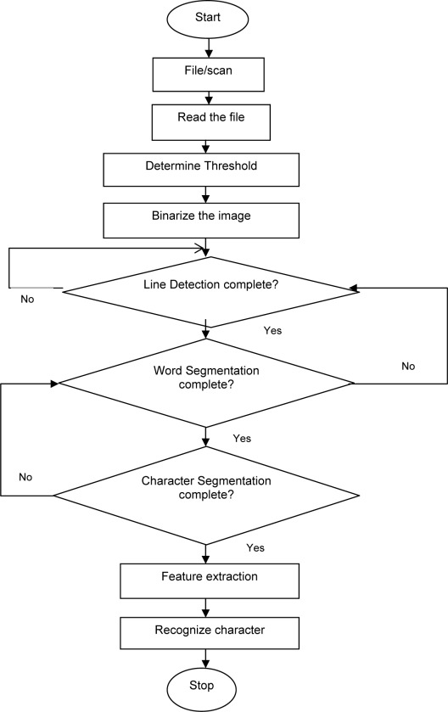
Flow chart

Slide 15
Literature Review
https://www.geeksforgeeks.org/advantages-and-disadvantages-of-optical-character-reader-ocr/
https://theenterpriseworld.com/7-benefits-of-image-to-text-converter/
https://tweakyourbiz.com/business/technology-trends/top-8-benefits-of-an-image-to-text-technology-for-your-business

Slide 16
Project Status
FRONT CODE IS READY
BACKEND CODE IS READY
WHILE CONNECTING THEM THERE IS SOME TECHNICAL SERVER ISSUE WE ARE WORKING ON IT

Slide 17
FRONT END
<html lang="">
<head>
<meta charset="utf-g">
<title>Image to Text</title>
<link rel="stylesheet" href="https://stackpath.bootstrapcdn.com/bootstrap/4.3.1/css/bootstrap.min.css" integrity="sha384-ggOyR0iXCbMQv3xipma34MD+dH/1fQ784/j6cY/iJTQUOhWr7x9JvRxT2MZw1T" crossorigin="anonymous">
</head>
<body>
<div class='text-center'><br><br>
<h1>Upload Image Below</h1>
<form method=POST enctype='multipart/form-data'>
<input type='file' class='btn btn-dark' name='photo'><br><br>
<input id='input' type='text' class='form-control' placeholder='enter image name...' name='img-name'><br>
<input class='btn btn-dark' type='submit'>
</form>
</div>
</body>
<style>
#input{
margin:auto;
width: auto;
}
</style>
</html>

Slide 18
BACK END
from flask import Flask, render_template, request
from werkzeug.utils import secure_filename
from werkzeug import secure_filename, FileStorage
import os, pytesseract
from flask_uploads import UploadSet, configure_uploads, IMAGES
from PIL import Image
project_dir = os.path.dirname(os.path.abspath(file))
app = Flask(name,
static_url_path='',
static_folder='static',
template_folder='template')
photos = UploadSet('photos', IMAGES) # folder
app.config['DEBUG'] = True
app.config['UPLOAD_FOLDER'] = 'images'
# class for image to text
class GetText(object):
def init(self, file):
self.file = pytesseract.image_to_string(Image.open(project_dir + '/images/ ' + file))
app = Flask(name, template_folder='template')
@app.route('/', methods=['GET', 'POST'])
def home():
if request.method == 'POST':
if 'photo' not in request.files:
return 'there is no photo in form'
name = request.form['img-name'] + '.jpg'
photo = request.files['photo']
path = os.path.join(app.config['UPLOAD_FOLDER'], name)
photo.save(path)
textObject = GetText(name)
print('TEXT OBJECT' + textObject.file)
return textObject.file
return render_template("conversion.html")
if name == 'main':
app.run()

Slide 19
GitHub setup
https://github.com/CHIHNITA-REDDY-B
https://github.com/NIKHITHA-SIRISILLA
https://github.com/KONDURISHIVANI
https://github.com/RAJASHRINOULURI
Repository of group
https://github.com/CHIHNITA-REDDY-B/SE-project

Slide 20
Division of work among the group members
2110030359- Back End ,Front End
2110030320-Front End
2110030284-Front End
2110030283-Front End

Slide 21
THANK YOU

